Slide 1
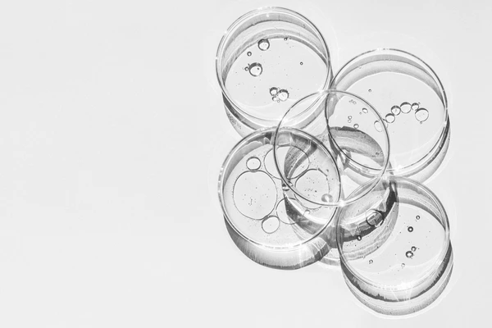
Exploration of Ultraconserved Elements in Bacteria
By: Chiemeka Nwakama, Curtis Kokuloku, Jonathan Haak

Slide 2
Introduction
In the world of genomics, there is often a focus on the differences between RNA sequences
There is also a focus on similarity in the sense of how similar other organisms are to each other
Despite our differences, all living things originate from the same single celled organisms and as a result, even through millions of years of evolution, it can be seen that there are some things coded in very different bacteria for example that are 100% percent identical
These are known as Ultra-Conserved Elements
(Ryu, 2012)
Notes:
A typical genomic analysis often focuses on understanding the differences between organisms by comparing gene and RNA sequences that differ.
But even though millions of years of evolution have introduced many changes, we still see some remarkable similarities in living things originating from that first common ancestral organism.
Certain elements of DNA/RNA in genetically distinct organisms like bacteria are found to be 100% identical or ultra-conserved.
We want to better understand what these ultra-conserved elements are
why they remained unchanged through evolution, and what essential functions they likely serve.
Our project explored and analyzed ultra-conserved genetic elements across evolutionarily diverse bacteria species spanning millions of years (since they shared a common ancestor).
Finding these elements can reveal fundamental building blocks of bacteria genetics.

Slide 3
Why Care About Ultraconserved Elements?
Can tell us about relationship between very different organisms
Can help us discover “essential protein” and functions
They're interesting
Notes:
Why do we care?
Identifying ultra-conserved elements across diverse bacteria that split evolutionarily millions of years ago
Allows us to better understand evolutionary relationships between very distinct modern species.
It helps trace lineage.
These conserved sequences likely encode proteins that serve as essential functions for bacteria to survive and propagate.
So it can provide us clues into the most fundamental and critical proteins.
From a basic science perspective, it is fascinating that sequences coding for critical conserved proteins stay identical across organisms that otherwise evolved significant genetic differentiation.
‘What key constraints kept these the same?’ is an intriguing question that can be answered through conversations and research.

Slide 4
Pre Processing and Data Selection
Randomly selected 20 bacteria genomes
Read in the Genomes
Added “NNNNNNNNNNNN…” to parts of the genomes that were not connected (scaffolds)
Stored in List

Slide 5
Implementation and Development
Implemented an algorithm to find 100% conserved elements based on:
Parameters:
reference sequence
number of sequences conserved threshold
number of bases per conserved element
number of kmers to explore
Maximal Frequent Sets (within +10 length of bases)
Run BLASTN and BLASTX on conserved elements found

Slide 6
A different approach
Instead of keeping same parameters for the length of kmers same based on maximal frequent sets (capped off at 200)
Adjustable parameters as mentioned before

Slide 7
How it works
ATATTGGGCCGTTGGTGGAGG
First kmer (length 20)
Second kmer (length 20)

Slide 8
Limitations
Only did the first 10,000 kmers for each reference sequence
Were only able to use 10 out of the 20 genomes as reference
BLAST did not find anything for search for some elements found a given reference genome

Slide 9
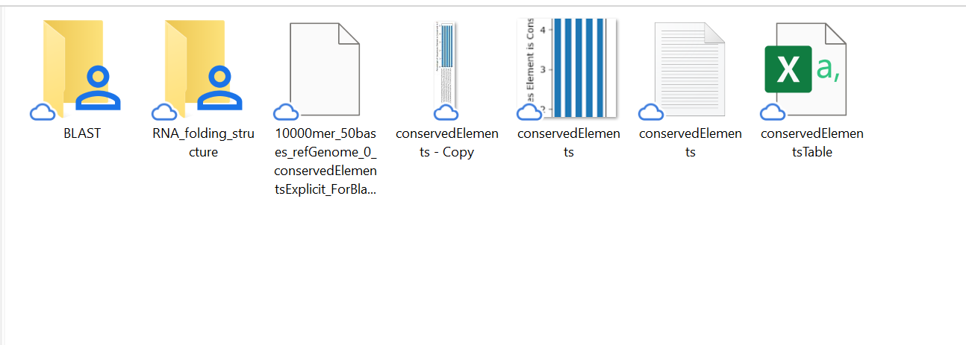
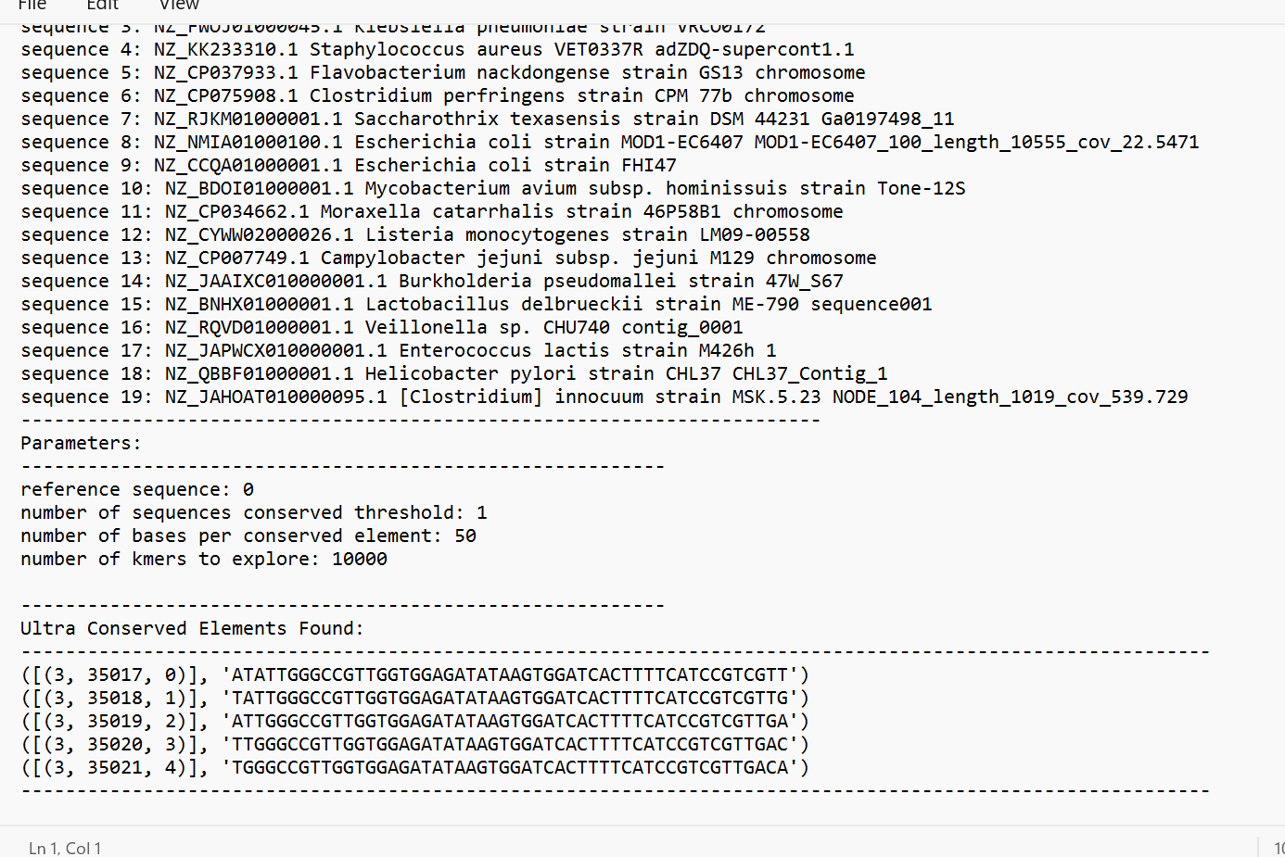
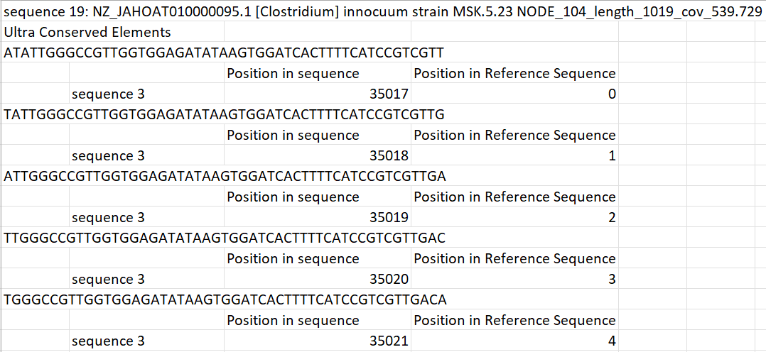
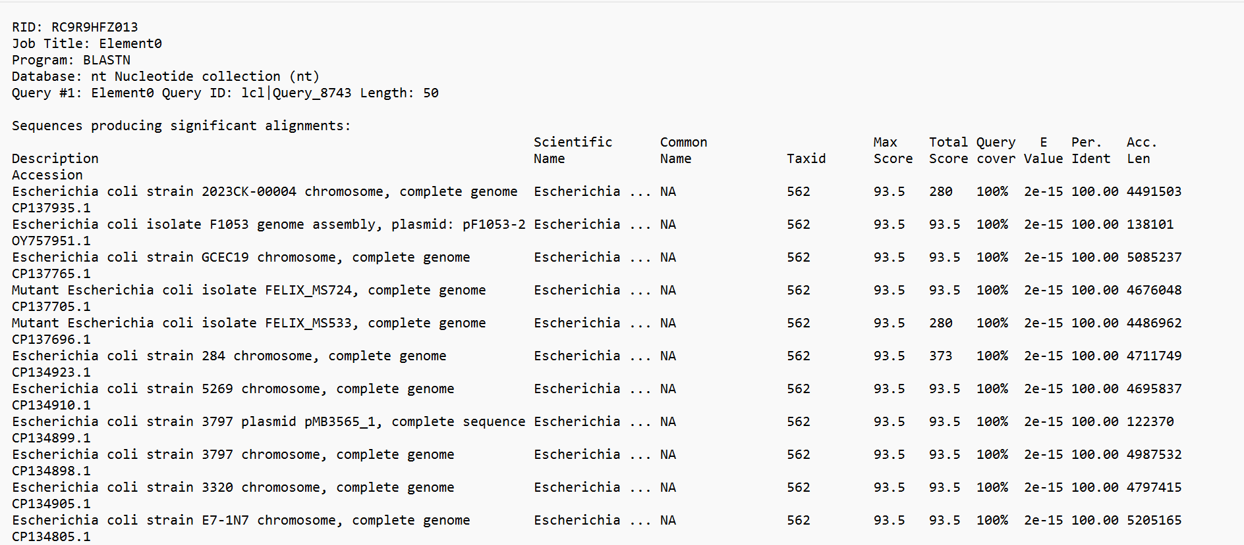
Files Produced
I

Slide 10
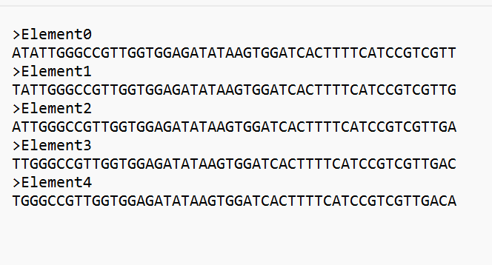
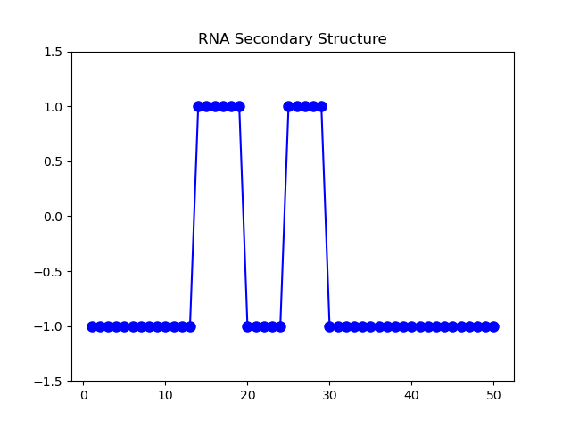
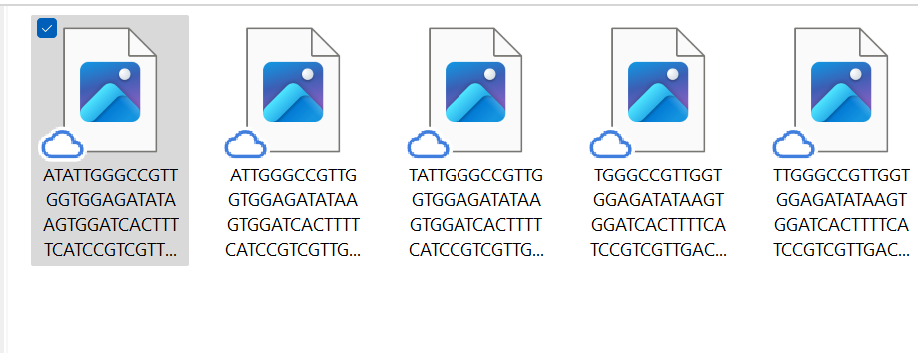
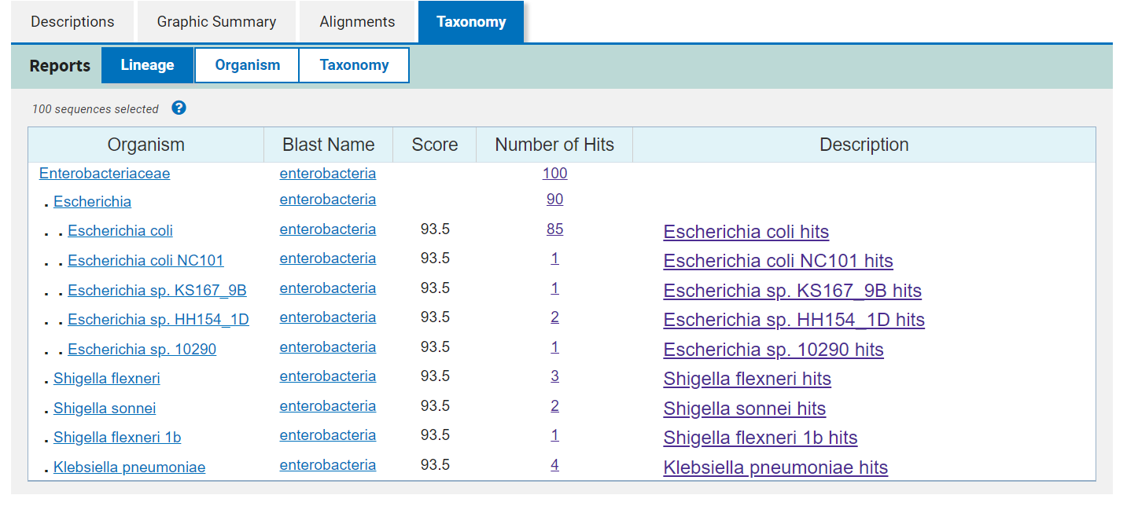
Files Produced
I

Slide 11
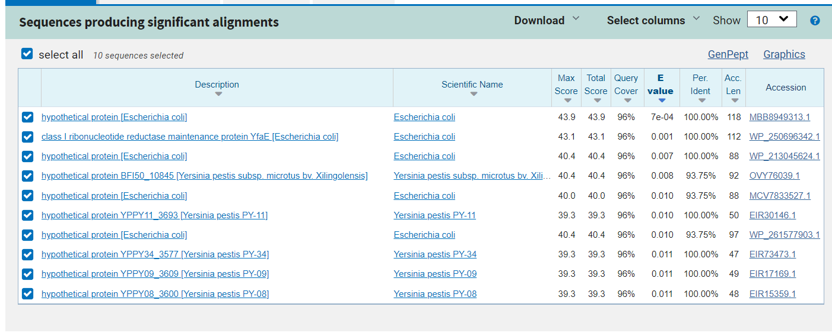
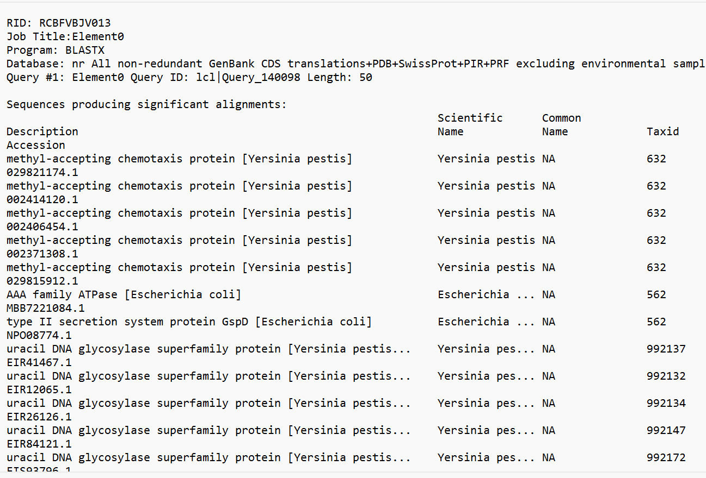
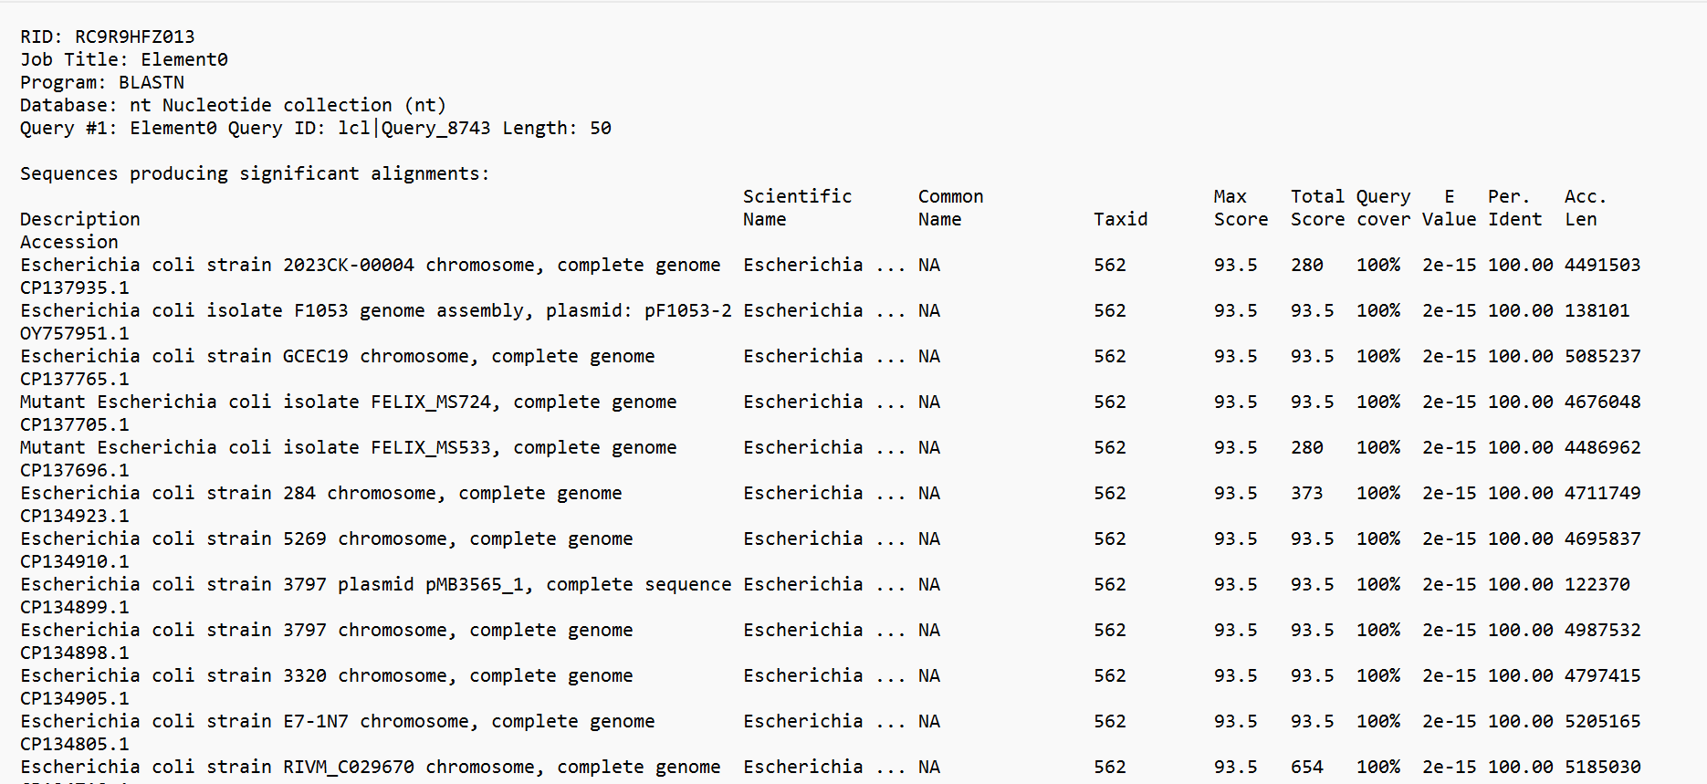
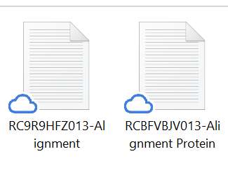
Files Produced

Slide 12
Genomes:
------------------------------------------------------------------------
sequence 0: NZ_NYJR01000001.1 Yersinia pestis strain 42126 42126_contig001
sequence 1: NZ_CAAKBY010000001.1 Clostridioides difficile strain LSHTM-81
sequence 2: NZ_JABBWS010000001.1 Micrococcus luteus strain MFP06 1
sequence 3: NZ_FWOJ01000045.1 Klebsiella pneumoniae strain VRCO0172
sequence 4: NZ_KK233310.1 Staphylococcus aureus VET0337R adZDQ-supercont1.1
sequence 5: NZ_CP037933.1 Flavobacterium nackdongense strain GS13 chromosome
sequence 6: NZ_CP075908.1 Clostridium perfringens strain CPM 77b chromosome
sequence 7: NZ_RJKM01000001.1 Saccharothrix texasensis strain DSM 44231 Ga0197498_11
sequence 8: NZ_NMIA01000100.1 Escherichia coli strain MOD1-EC6407 MOD1-EC6407_100_length_10555_cov_22.5471
sequence 9: NZ_CCQA01000001.1 Escherichia coli strain FHI47
sequence 10: NZ_BDOI01000001.1 Mycobacterium avium subsp. hominissuis strain Tone-12S
sequence 11: NZ_CP034662.1 Moraxella catarrhalis strain 46P58B1 chromosome
sequence 12: NZ_CYWW02000026.1 Listeria monocytogenes strain LM09-00558
sequence 13: NZ_CP007749.1 Campylobacter jejuni subsp. jejuni M129 chromosome
sequence 14: NZ_JAAIXC010000001.1 Burkholderia pseudomallei strain 47W_S67
sequence 15: NZ_BNHX01000001.1 Lactobacillus delbrueckii strain ME-790 sequence001
sequence 16: NZ_RQVD01000001.1 Veillonella sp. CHU740 contig_0001
sequence 17: NZ_JAPWCX010000001.1 Enterococcus lactis strain M426h 1
sequence 18: NZ_QBBF01000001.1 Helicobacter pylori strain CHL37 CHL37_Contig_1
sequence 19: NZ_JAHOAT010000095.1 [Clostridium] innocuum strain MSK.5.23 NODE_104_length_1019_cov_539.729
------------------------------------------------------------------------

Slide 13
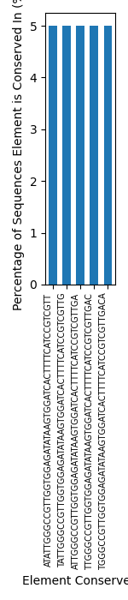
10000mer_50bases_refGenome_0_conservedElements Graph

Slide 14
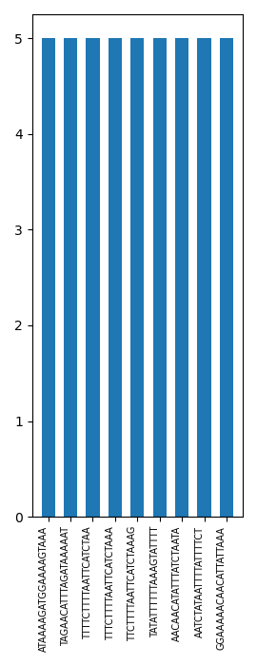
10000mer_20bases_refGenome_1_conservedElements Graph

Slide 15
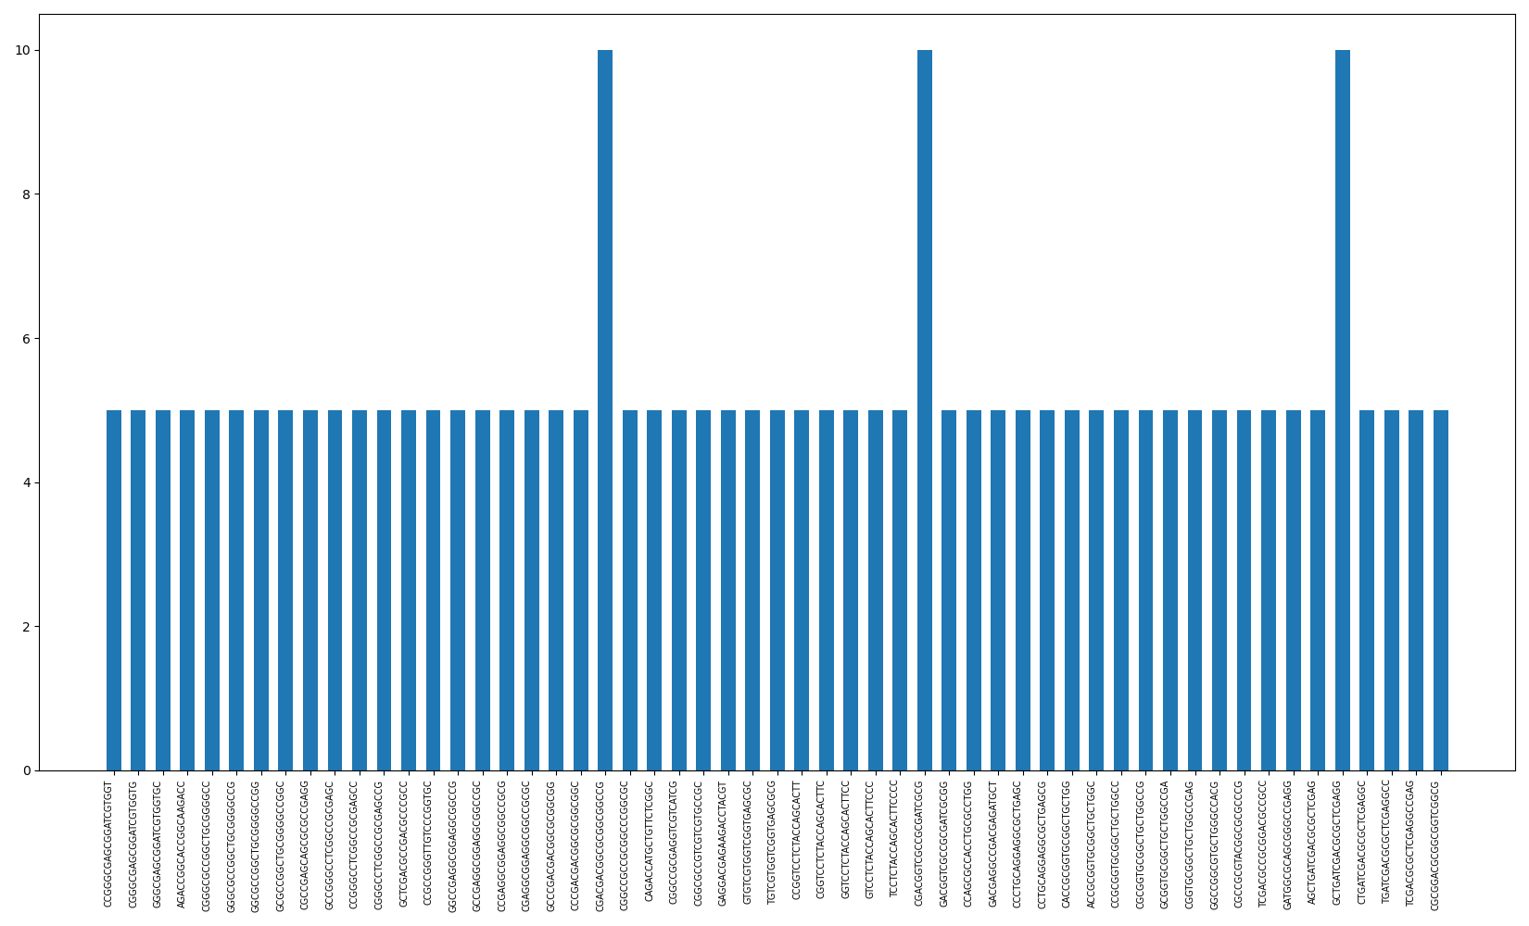
10000mer_20bases_refGenome_2_conservedElements Graph

Slide 16
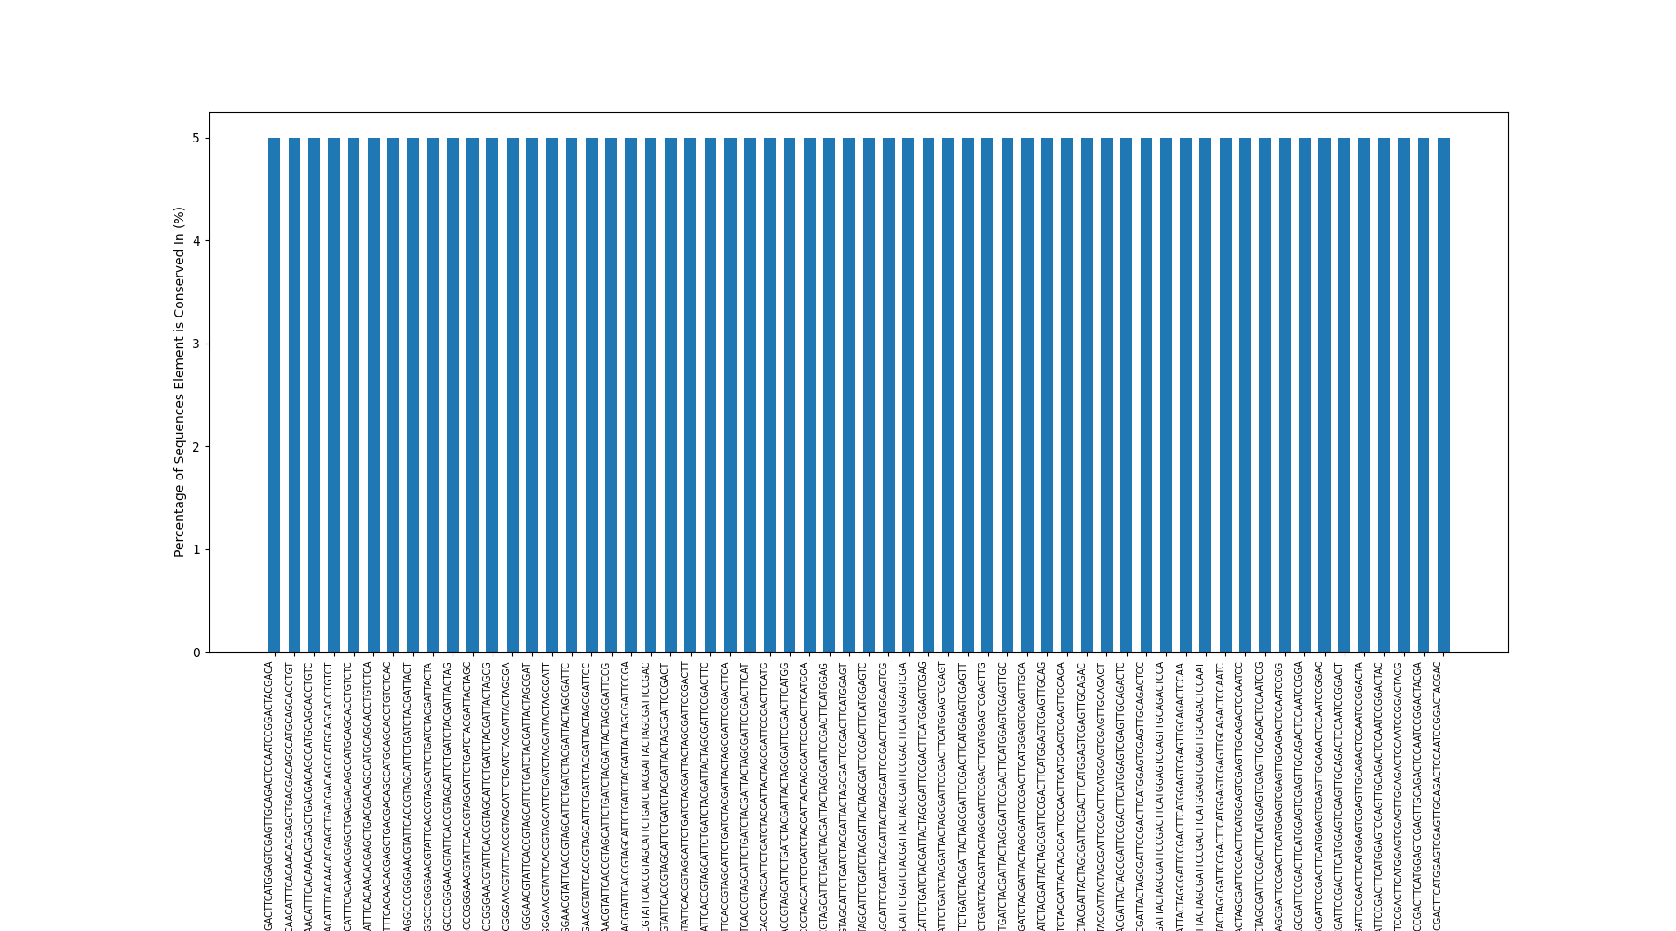
10000mer_200bases_refGenome_3_conservedElements Graph

Slide 17
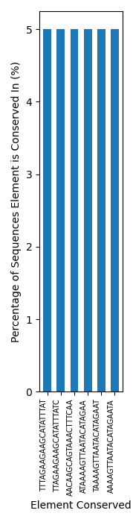
10000mer_20bases_refGenome_4_conservedElements Graph

Slide 18
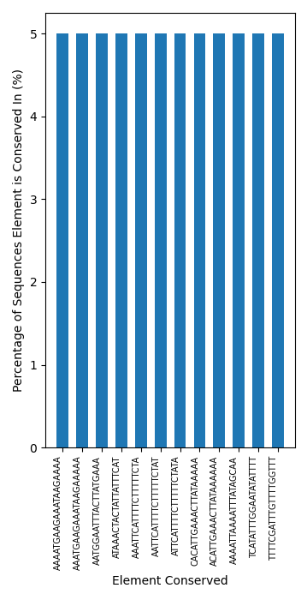
10000mer_20bases_refGenome_5_conservedElements Graph

Slide 19
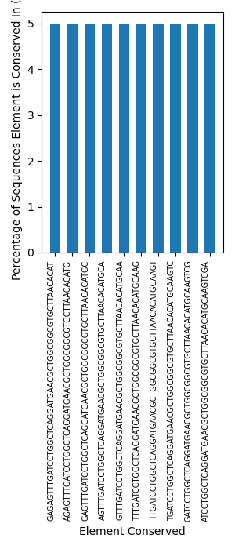
10000mer_50bases_refGenome_6_conservedElements Graph

Slide 20
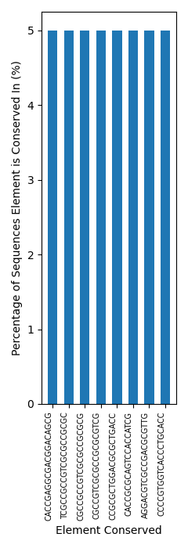
10000mer_20bases_refGenome_7_conservedElements Graph

Slide 21
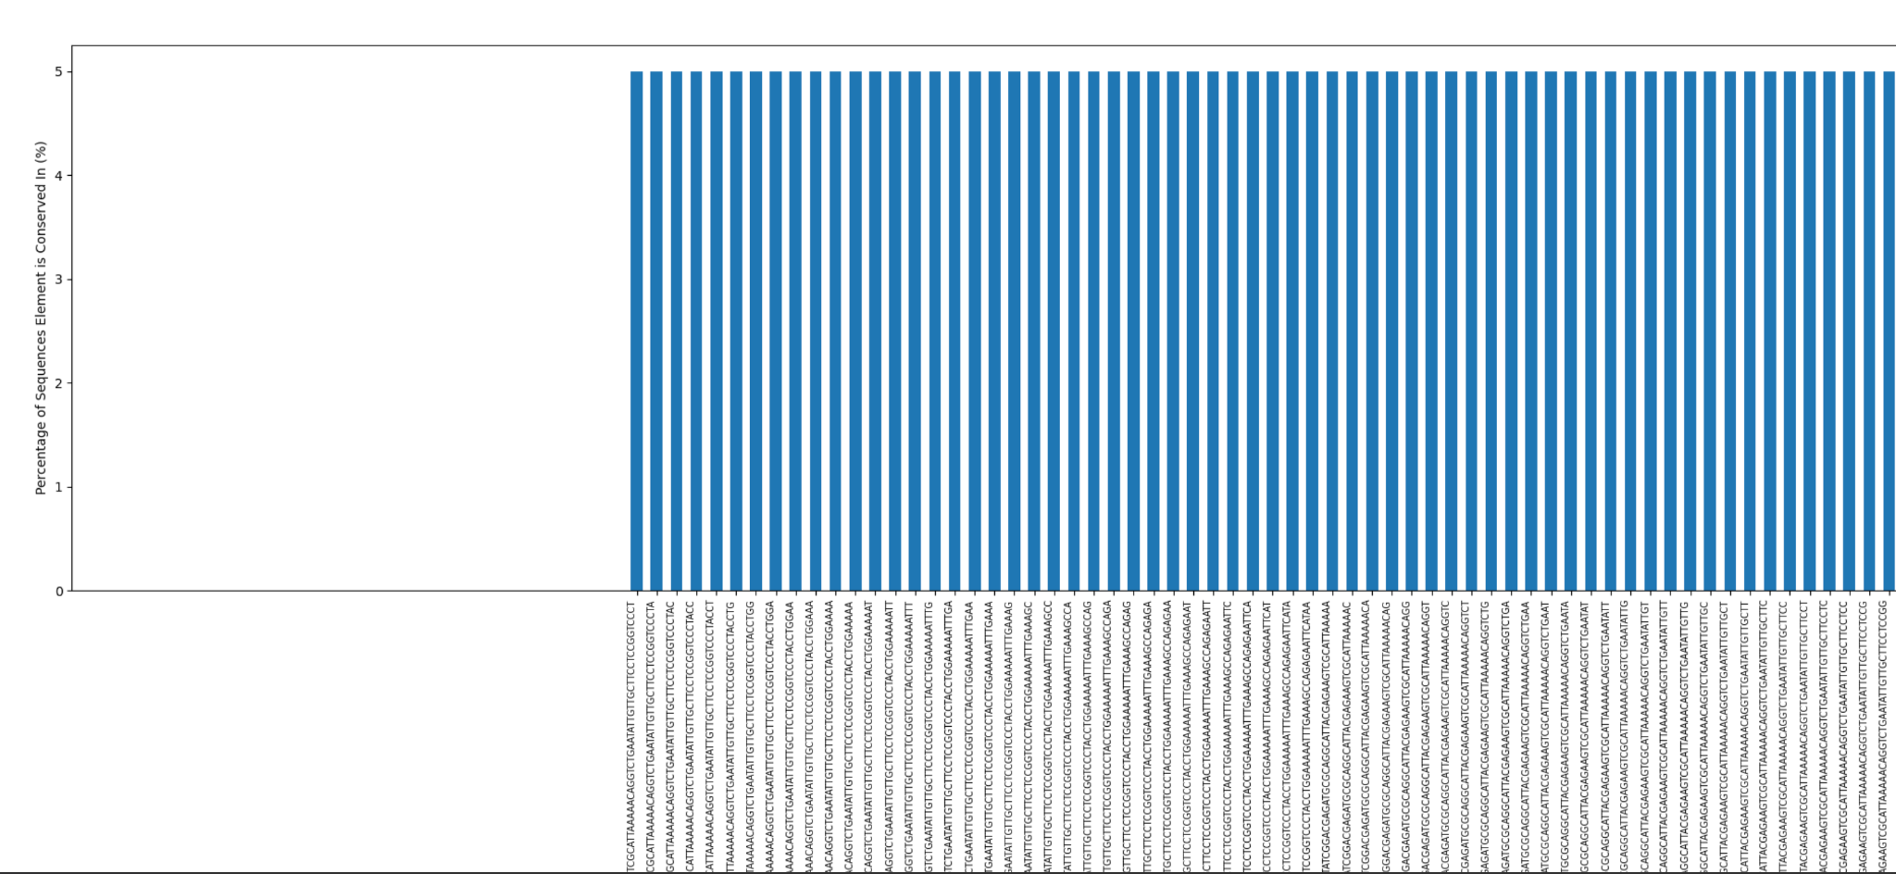
10000mer_200bases_refGenome_8_conservedElements Graph

Slide 22

10000mer_200bases_refGenome_9_conservedElements Graph

Slide 23
RNA Secondary Structure Genome 0
Conserved element form Genome 0
Conserved element from Genome 0

Slide 24
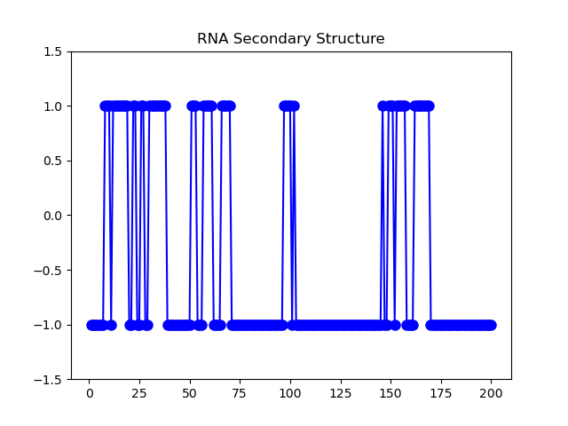
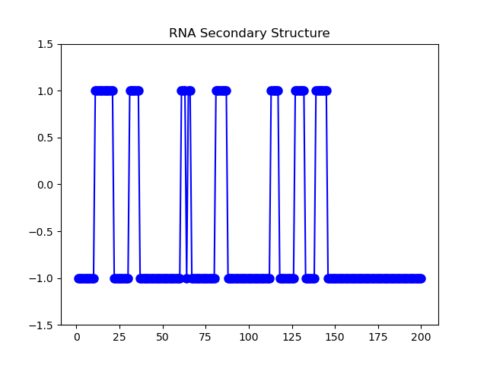
RNA Secondary Structures Genome 8 and 9
Conserved element from Genome 8
Conserved element from Genome 9

Slide 25
Results:
Genome 0 (50mers) --- 3
Genome 1 (20mers) ---9,5,12,13,15,3
Genome 2 (20mers) --- 7, 14, 3, 10
Genome 3 (200mers) -- 0, 9
Genome 4 (20mers) --- 6, 13, 1
Genome 5 (20mers) ---- 6, 9, 13, 1, 17
Genome 6 (50mers) --- 2
Genome 7 (20mers) --- 10, 14, 2
Genome 8 (200mers) --- 9
Genome 9 (200mers) --- 8

Slide 26
Results: Key findings
Most common kmer length: 20 in 5 reference genomes
Relatively short conserved sequence length, genomes may share more basic and simple sequences, but not more complex sequences that serve a more custom functionality
Conserved Sequences between different E. Coli species were much longer!
Many proteins were hypothetical
Meaning Sequence is expected to code for a protein, but that this has not been experimentally confirmed yet
Positions tended not to match up even in E.colis
Many conserved sequences mapped to conserved proteins with relatively simple secondary structures
Possibly indicating a more fundamental and basic role that these proteins play, a role that is necessary for many different bacterial species
Conserved proteins between E. coli species had much more complex secondary structures

Slide 27
Further Research and Improvement
We hope that this research will further additional ultra element exploration
Compare with Data from other sources
Cross reference conserved sequences between different species, with how long they split from a common ancestor
Evaluate protein function data to determine whether sequences that code for certain functions are conserved more often, or conserved more often in specific scenarios for specific species
Use faster language such as C or use C based libraries in Python
Due to computational limits, we were unable to process and evaluate the majority of the data for each species

Slide 28
References
Ryu, T., Seridi, L. & Ravasi, T. The evolution of ultraconserved elements with different phylogenetic origins. BMC Evol Biol 12, 236 (2012). https://doi.org/10.1186/1471-2148-12-236
Licastro, D., Gennarino, V.A., Petrera, F. et al. Promiscuity of enhancer, coding and non-coding transcription functions in ultraconserved elements. BMC Genomics 11, 151 (2010). https://doi.org/10.1186/1471-2164-11-151
Winker, K., Glenn, T. C., & Faircloth, B. C. (2018). Ultraconserved elements (UCEs) illuminate the population genomics of a recent, high-latitude avian speciation event. PeerJ, 6, e5735. https://doi.org/10.7717/peerj.5735
Brant C. Faircloth, John E. McCormack, Nicholas G. Crawford, Michael G. Harvey, Robb T. Brumfield, Travis C. Glenn, Ultraconserved Elements Anchor Thousands of Genetic Markers Spanning Multiple Evolutionary Timescales, Systematic Biology, Volume 61, Issue 5, October 2012, Pages 717–726, https://doi.org/10.1093/sysbio/sys004
U.S. National Library of Medicine. (n.d.). Nucleotide blast: Search nucleotide databases using a nucleotide query. National Center for Biotechnology Information. https://blast.ncbi.nlm.nih.gov/Blast.cgi?PROGRAM=blastn&amp;BLAST_SPEC=GeoBlast&amp;PAGE_TYPE=BlastSearch

